Slide 1
Preparing for Recovery and Financial Sustainability
Mazars Webinar
Friday, 5th June 2020

Slide 2
Preparing for Recovery & Financial Sustainability
Introduction: Economic Environment and Outlook
Crisis Management: Preparing for a Recovery Period
Crisis Management: Statutory Instrument Options
- MAZARS

Slide 3
INTRODUCTION: ECONOMIC ENVIRONMENT & OUTLOOK
- MAZARS

Slide 4
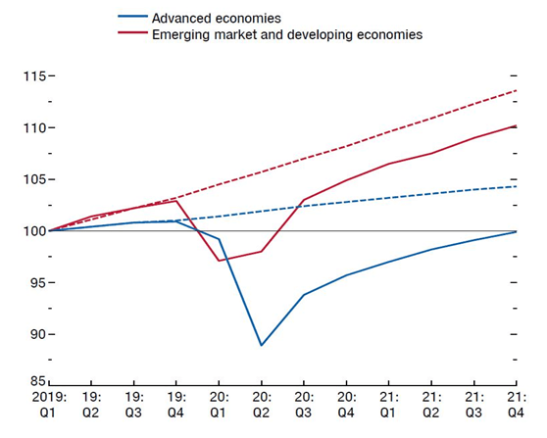
Introduction: Economic Environment & Outlook
Quarterly World GDP (Dashed lines indicate estimates from January 2020 World Economic Outlook, 2019:Q1=100)
Pre Crisis Budget vs Post Crisis Budget
Annual global GDP growth is projected to contract sharply by 3% in 2020, compared to 2.9% growth in 2019, and January estimates of 3.3% growth for 2020.
The IMF suggests we would experience a strong rebound of 5.8% growth in 2021. Of course these estimates are surrounded by huge uncertainty around how the pandemic unfolds.
The adverse impact on confidence, financial markets, the travel sector and disruption to supply chains contributes to the downward revisions in all G20 economies in 2020-21, particularly ones strongly interconnected to China, such as Japan, Korea and Australia.
Supportive macroeconomic policies will help to restore confidence and aid the recovery of demand as virus outbreaks ease, but cannot offset the immediate disruptions that result from enforced shutdowns and travel restrictions.
Source: Central Bank, April 2020: https://www.centralbank.ie/news/article/covid-19-the-irish-economy-in-a-global-context
- MAZARS

Slide 5
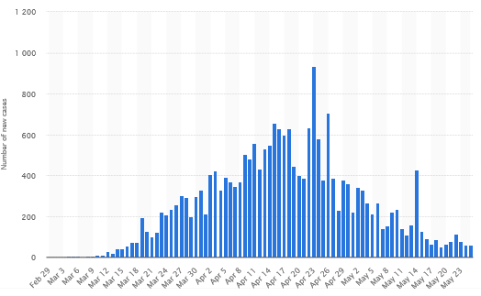
Introduction: Economic Environment & Outlook - CASES AND TIMELINE in Ireland
Number of new cases
Official Lockdown
Mandatory stay at home order begins with restrictions on non essential services
New temporary wage subsidy announced
20,000 cases
1,200 deaths
>425k employees are on the wage subsidy scheme
>600k people on pandemic unemployment payment
5 Phases introduced
First few cases are confirmed
All schools to close for 2 weeks
All pubs and bars ordered to close
First death
Phase 1 of restrictions road map begins
1,500 deaths
Graph source: Statista, May 2020: https://www.statista.com/statistics/1107064/coronavirus-cases-development-ireland/
- MAZARS

Slide 6
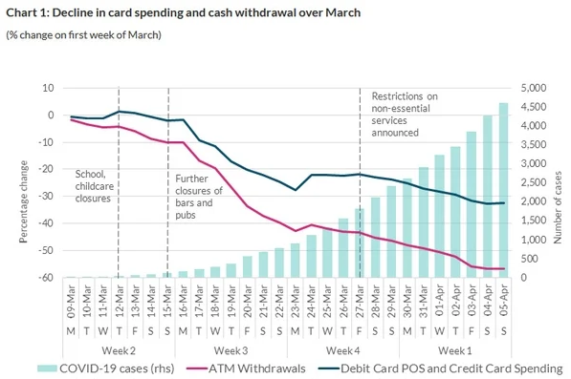
Introduction: Economic Environment & Outlook - CONSUMER SENTIMENT AND SPEND in Ireland
Irish Consumer Sentiment & Spend Timeline
Data published by Central Bank of Ireland has found that spending on credit and debit cards initially increased as the government announced the first set of containment measures on 12 March, before falling in the second half of the month
Meanwhile, the daily value of cash withdrawals from ATMs collapsed by 40 per cent over the same period.
By the end of March, retail card spending (point of sale and credit card) had declined by 27 per cent
Total card transactions (including ATM usage) for March amounted to €5.4 billion. This represents a decline of 9 per cent when compared with March 2019
March was a month of two halves with respect to retail spending. The first half characterised by an increase in card usage and spending, while the announced restrictive measures had a dramatic impact on spending patterns in the second half of the month.
Percentage change
Number of new cases
Source: Central Bank, April 2020: https://www.centralbank.ie/statistics/statistical-publications/behind-the-data/how-has-the-covid-19-pandemic-affected-daily-spending-patterns
- MAZARS

Slide 7
Introduction: Economic Environment & Outlook – AFFECTED SECTORS
Affected Industries & Sectors
Retail
Hospitality
Travel & Tourism
Oil & Gas
Technology
- MAZARS

Slide 8
Crisis Management: Preparing for a Recovery Period
- MAZARS

Slide 9
Introduction: Economic Environment & Outlook – THE CORE ECONOMIC PHASES
Outlook for business owners & key questions
5 Phased Approach - Ireland
Key Economic Phases of the Crisis
Lead-in Phase
Acute Phase
Suppression Phase
Recovery Phase
Typically 1 – 2 weeks
Typically 10 – 12 weeks
Typically 9 – 12 months
Typically 2 – 3 years
How long will the phases last, and when could the suppression and recovery phases begin for my business?
Is my business strong enough financially to sustain each phase?
What will the restrictions during the coming phases look like and how will these restrictions impact my business?
How can I protect my business and best prepare for the coming phases?
- MAZARS

Slide 10
CRISIS MANAGEMENT: PREPARING FOR A RECOVERY PERIOD
The Mazars 6 phased approach to crisis management planning:
MAZARS BUSINESS & FINANCIAL SUSTAINABILITY PROGRAM
- MAZARS

Slide 11
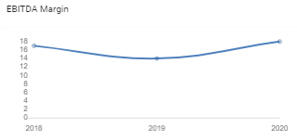
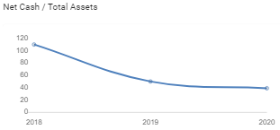
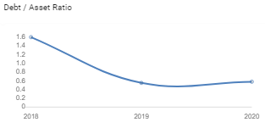
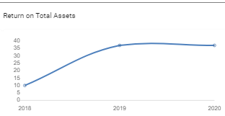
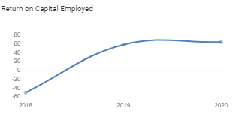
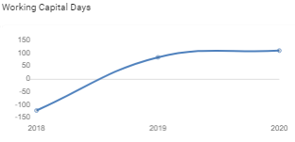
CRISIS MANAGEMENT: PREPARING FOR A RECOVERY PERIOD
Phase 1: Pre crisis track Record
Illustrates the last 3 years of performance and defines the starting point / pre crisis baseline in terms of
- Revenue
- Cost Base Profile
- Profit
- Cashflow
- Balance Sheet Strength
Demonstrates to relevant third parties (i.e. lenders) that the business had viable trading performance pre crisis
- MAZARS

Slide 12
CRISIS MANAGEMENT: PREPARING FOR A RECOVERY PERIOD
1. Impact on Sales Volume / Cost of sales / Other Costs & Losses / Profit / Balance Sheet
 | Acute Phase | Suppression Phase | Recovery Phase
HIGH
MEDIUM
LOW
NONE
POSITIVE
Products / Services
Phase 2: Covid-19 Impact Assessment
Assessment of the impact of the crisis on the top line sales because of crisis induced issues and the resulting impact on other financial areas
Analysis of current cost base profile across to gain an understanding of essential and expendable costs
Identification of the gap on all the major measures of performance between the current budgets and the initial crisis forecasts.
Evaluation of the likely duration & intensity of each pandemic stage (acute, suppression, recovery).
Assessment of the viable national funding supports.
 | ACUTE |  |  | SUPRESSION |  |  | RECOVERY
 | Probable | Worst | Best | Probable | Worst | Best | Probable | Worst | Best
Gross Profit
Net profit
Asset Base
Working Capital
Cash
Reserves
- MAZARS

Slide 13
Crisis MANAGEMENT: PREPARING FOR A RECOVERY PERIOD
Phase 3: Crisis Management Priorities & Strategies
Agree the core priorities and objectives of the shareholders which should guide the development of a revised operational and business plan for the crisis period
Define the strategic themes to respond to specific challenges identified and deliver the overall plan
Carry out scenario analysis and financial modelling to assess all survival options
- MAZARS

Slide 14
Crisis MANAGEMENT: PREPARING FOR A RECOVERY PERIOD
What are the priorities of the shareholders and senior executive team?
Identify Top Priorities:
Scope Crisis Management Plan:
Manage the cash gap
Address the immediate and critical issues
Protect shareholder investment and reserves at all costs
Preserve competitive edge and key value propositions for a post crisis environment
Cut costs, avail of government support and bridge the cash gap
Balance the needs of all stakeholders, in particular staff and suppliers
Willing to adapt business in response to fundamental changes required
Assesses the realistic survival options going forward
Seek external financial supports / facilities
Avail of government financial supports
Quantify the financial impact of our survival options
Seek collaborative opportunities with competitors / suppliers / customers
- MAZARS

Slide 15
Crisis MANAGEMENT: PREPARING FOR A RECOVERY PERIOD
Assess the realistic survival options and strategies going forward
1.
Close Down Permanently & Liquidate
Close business and liquidate assets.
2.
Close Down Temporarily
Close the business for 12 – 18 months and reopen when all restrictions have been lifted
Financial Modelling
and
Scenario Analysis
3.
Remain Open With Restrictions
Remain open and operate under social distancing restrictions.
4.
Adapt Business Model & Remain Open With Restrictions
Remain open and operate under a different more lucrative business model in order to drive sales and activity
- MAZARS

Slide 16
Crisis MANAGEMENT: PREPARING FOR A RECOVERY PERIOD – decision tree
Assess the realistic survival options and strategies going forward
Option 1: Cease Trading & Liquidate
Option 2: Close Down Temporarily (12 – 18 Months)
Option 3: Remain Open With Restrictions
Option 4: Adapt Business Model & Open With Restrictions
Does the option align with the shareholders' priorities?
NO
YES
Is there further investment required
Estimate: €£$
Option deemed feasible
NO
YES
Option deemed unfeasible
Are the shareholders willing to invest required amount?
NO
Is alternative funding available
NO
YES
YES
Does the business model require significant change?
NO
YES
Is the risk adjusted return on investment:
YES
Are the changes feasible and the associated costs / business case quantified
<0
Low
Mid
High
NO
Further analysis required
Assess Business
Case Assumptions
Option deemed feasible
- MAZARS

Slide 17
Crisis MANAGEMENT: PREPARING FOR A RECOVERY PERIOD – decision tree
Develop Action Plans Centred around 6 Core Themes:
Phase 4: Crisis Action Plan
Develop a new suite of management and operational plans that can continue to meet the ongoing needs of customer base and at the same time support the delivery of the crisis priorities
Develop a viable and realistic suite of tactics and action plans, including external funding / supports required, to deliver on priorities identified
Build the plans around the most likely scenario yet at the same time identify additional contingency actions that need to be taken should revenues be significantly below the most likely, or significantly higher, than the most likely scenario
Incorporate the crisis action plan into the current baseline financial model and quantify the financial impact of these actions during the crisis period over a number of scenarios of: probable, worst and best case.
.
- MAZARS

Slide 18
Crisis MANAGEMENT: PREPARING FOR A RECOVERY PERIOD
Develop crisis action plan across major themes:
Sales decline mitigation
Pursue new revenue streams
Pursue alternative sales channels
Mothball trading activity
Quantify financial impact on sales
Develop detailed actions to deliver objective
Assign timelines, milestones & owners
Avail of viable finance options
Avail of viable government supports
Avail of available concessions
Avail of available grant funding
Renegotiate loan terms
Quantify financial impact of external supports
Develop detailed actions to deliver objective
Assign timelines, milestones & owners
Operational cost reductions & matching
Pursue alternative supply chains
Implement alternative operational model
Quantify financial impact on cost of sales
Develop detailed actions to deliver objective
Assign timelines, milestones & owners
Manage / renegotiate payment terms with suppliers
Optimize stock levels in accordance with trade
Manage customer relationships & debtors
Quantify financial impact on working capital
Develop detailed actions to deliver objective
Assign timelines, milestones & owners
Overhead cost reductions
Renegotiate of long term agreement costs
Alternative support delivery (i.e. remote, outsourcing etc.)
Health & safety
Quantify financial impact on overheads
Develop detailed actions to deliver objective
Assign timelines, milestones & owners
Restructure responsibilities amongst management team
Manage the change required to business model
Manage the change required to operations
Quantify any further financial implications
Develop detailed actions to deliver objective
Assign timelines, milestones & owners
- MAZARS

Slide 19
Crisis MANAGEMENT: PREPARING FOR A RECOVERY PERIOD
BASELINE PRE CRISIS PROJECTIONS
1.
Phase 5: Revised Forecast & Financial Plan
Incorporate the crisis action plan into the current baseline financial model and quantify the financial impact of these actions during the crisis period over a number of scenarios of: probable, worst and best case.
Ensure the revised financial plan meets all of the fundamental objectives and priorities of the shareholders.
Assess whether the revised financial plan and underlying assumptions are realistic and the associated remedial actions are practical, feasible and flexible
IMPACT OF CRISIS
2.
IMPACT OF MITIGATING ACTION PLAN
3.
CRISIS FINANCIAL FORCAST
- MAZARS

Slide 20
CRISIS MANAGEMENT: PREPARING FOR A RECOVERY PERIOD
Track the performance of the plan across 3 economic phases:
Phase 6: Execution & Monitoring
Assess the operational performance compared to plan on monthly basis – actual vs revised budget
Review of changing environment and analysis of the continued relevance of key planning assumptions and tactics
Monitoring timing and impact of each of the crisis phases to ensure the operational plans and cost base remain consistent with the changing needs of the business
Amendment and development of new plans and actions when needed as appropriate
ACUTE
SUPPRESSION
RECOVERY
- MAZARS

Slide 21
Crisis Management: Statutory Instrument Options
- MAZARS

Slide 22
COVID-19
Corporate Restructuring Options
Tom O’Brien FCA -5th June 2020

Slide 23
Context

Slide 24
Unprecedented economic Landscape
Cocooned Economy
The Covid Pandemic has created unprecedented economic challenges and impacted on how companies do business
Many Companies have continued to incur considerable operating costs while unable to trade as normal
Return to Growth
Opinions differ on how economies will rebound as business and society emerge from the lockdown phase
Impact will vary across Industries due to continued restrictions and changing customer habits
Adapting
Existing business models may need to be reassessed
Activity levels may not be return to previous levels
Working from home and other social changes will impact customer habits
Finances
Many Companies will have seen their cash reserves significantly reduced
Forbearance from creditors likely to reduce as business activity returns
Returning to normal trading levels will require working capital funding

Slide 25
RESTRUCTURING OPTIONS

Slide 26
Restructuring Options
New funding/ Debt Restructure
Seek new bank funding or restructure existing facilities
External Investment
Examinership
A formal insolvency mechanism that gives the Company protection from its Creditors in order to restructure and trade on a solvent basis going forward
INFORMAL SCHEME oF Arrangement
Engage with key creditors to renegotiate payment terms or write downs
No Court involvement
Can be contingent on other creditors/ classes of creditors agreeing on same
Parties contract to waive debt
Cost Effective
Formal SCHEME oF Arrangement
Court oversight and approval
More cost effective than Examinership, requires the agreement of at least 75% of value of creditors
Suitable where you have a narrow band of creditors or where you need to deal with a single class of creditor
Liquidation
Where the Directors no longer believe the business is viable
If the Company is solvent can be used as a tax effective way to extract value
Sale of Business
Likely to be difficult in the short to medium term

Slide 27
Examinership

Slide 28
What Is Examinership ?
Court Process
Under Section 509 of the Companies Act 2014, the Court is granted the power to provide temporary protection to a Company from its creditors
Insolvent
The Company must be able to demonstrate to the Court that it is unable to pay its debts as they fall due or that the value of its assets is less than its liabilities
Viable
The Court must be satisfied that the Company has a reasonable prospect of survival as a going concern
Objective
The process allows a Company to restructure its balance sheet and other contractual commitments to enable it to trade viably going forward

Slide 29
Requirements FOR A Successful Application
1. Insolvent
The Company must demonstrate that it is or is likely to be unable to repay its debts
7. Investment
That sufficient financial support can be secured in order to fund the scheme of arrangement
2. Future Viability
That subject to actions taken in the Examinership process, the Company will emerge as a viable going concern
6. Equitable to Creditors
It must be demonstrated that the outcome for creditors will be better than in an alternative insolvency scenario such as a Liquidation
3. Employment
The petition for Examinership must demonstrate that it will protect employment even if a certain level of rationalization is required to make the business viable
5. Support
The Company must be able to show it is likely to have the support of key suppliers and creditors
4. Cashflows
It must be demonstrated to the Court that the Company has a reasonable prospect of funding its operations through the period of Examinership

Slide 30
What Can Examinership Address ?
Legacy Creditors
Where a Company is fundamentaly viable but has significant historical creditor liabilities which it cannot generate sufficient free cash to discharge
The Examinership process can not reduce debt and force the Bank to stay with the Company
Debt cannot be reduced below the value of security held which can be difficult to quantify in trading scenarios
Can a debt write down coupled with a refinance be agreed ?
Bank Debt
The process can be used to repudiate onerous leases or as an opportunity to attempt to renegotiate lease terms, however the Landlord is not obliged to accept altered terms (personal guarantees cannot be repudiated in the process)
Onerous Leases
Contingent Liabilities
Significant potential liabilities such as claims can also be addressed in the process
Onerous Contracts
Contractual obligations either with suppliers or customers which are no longer sustainable can also be repudiated in the Examinership process.
Time To Restructure
The process provides the Company with a short but valuable period of protection from its creditors to restructure and reorganise

Slide 31
Other Considerations
Essential Creditors
Certain pre-Examinership Creditors will need to be discharged to maintain operations and Court approval will be required for them to be paid
Can a source of new investment be identified ?
On successfully exiting Examinership all pre-Examinership creditors need to be discharged in line with the terms of the Scheme of Arrangement
New Investment
Control
As part of the new investment new shareholders may emerge as the Examiner will be obliged to assess all offers in terms of its benefits to all stakeholders
The process can be costly
“Small Companies” as defined by the Companies Act can apply through the Circuit Court for Examinership which is more cost effective than the High Court option
Cost

Slide 32
WHO Can petition to put a company into examinership
01
The Company and its Directors
Where a creditor makes an application the Court will look negatively on the application if they believe the sole purpose is debt collection
02
Shareholder (>10%)
Applications by Creditors can be challenging due to insufficient information on trading performance
03
A Creditor
04
The Central Bank for specific company types

Slide 33
The Process
Petition
Review
Proposal
Exit
Day 0
Court Application seeking the Company to be placed in Examinership
On appointment the Examiner will commence a detailed review of the business and seek expressions of interest for same
A scheme of arrangement will be prepared based on offers of investment and put to each class of the Company’s Creditors for approval
Day 100
The proposal must ultimately be put before the Court for approval
In addition to the approval of one class of creditors the Court must be satisfied that the proposal is not unfairly prejudicial to the interests of any interested party

Slide 34
Independent Experts Report
The Petition to place a Company into Examinership is made by an application to the Circuit or High Court depending on the size of the Company.
A critical aspect of this process is the Independent Experts Report which the Judge will attach significant weight to in making his decision on whether to grant the Company the protection of the Court
Background
The report will document the background of the Company and the issues which have resulted in it requiring the protection of the Court
Balance Sheet
The report includes a balance sheet at the date of petition. The balance sheet will show the outcome to the various classes of creditors in a liquidation scenario as well as on a going concern basis
CashflowS
Cashflows projections that demonstrate the Company will generate sufficient cash through the period of Examinership
It should also be demonstrated that the Company can trade viably post examinership
Prospects for survival
The report must establish that subject to a scheme of arrangement being put in place and other necessary actions the Company has a reasonable prospect of emerging from Examinership as a viable enterprise

Slide 35
Role Of Examiner
Review
Proposal
Creditors
Executive Powers
The officers and agents are obliged to produce all books and records to the Examiner
The Examiner will engage in detail with the Directors in order to ascertain the actions required for the Company to reach agreement with its creditors and exit Examinership as a viable business
The Examiner will also assess sources of new investment
The Examiner formulates a compromise or scheme of arrangement to be put to the Company’s creditors
The scheme will set out the proposed dividends to the various classes of creditors and source of funding for same
The Examiner will also report on any other actions impacting creditors such as the repudiation of leases
A key role of the Examiner is to engage with the Company’s creditors in order to seek their support for the scheme of arrangement
In order for the Scheme of Arrangement to be put before the Court for approval “a majority in number and value of those who vote from at least one class of creditors who’s interests or claims will be impaired” must approve it
The Directors maintain their responsibilities and duties for the day running of the business.
However in exceptional circumstances the Examiner can apply to Court for executive powers if he has concerns over how the Company is run. In practice it is highly unlikely the Examiner will take such action unless he has serious concerns of wrongdoing

Slide 36
Creditors in Examinership
Fixed Charge
Debt cannot be reduced below the value of the property.
Exposure to Examiner costs
Preferential Creditors
Predominantly Revenue, Employee entitlements and Local Authority rates
Support Important
Floating charge
Preferential Creditors ?
Risk of Value erosion ?
Unsecured Creditors
Tend to be normal trade/ business creditors.
Can expect to see a very significant write downs in their liabilities
Retention of Title
Creditors with valid retention of title cannot repossess their goods when a Company enters Examinership
Examiner will normally certify the cost of the goods as an expense of the Examinership
Contingent Liabilities
Provision for quantifying same
Contingent liabilities will generally be classified as unsecured creditors

Slide 37
Trading in Examinership
Credit
Suppliers likely to insist on cash on delivery or reduced credit terms
Debtors
Debtors might believe that the Company may not exit Examinership and that there is an opportunity to avoid repayment
Bookings & Contracts
Customers may be unwilling to purchase in advance until they are sure the Company will exit Examinership successfully
Business Relationships
Suppliers significantly impacted by the process may be unwilling to continue to supply
Employees
The process can create uncertainty for Employees and reassurance will be required throughout the process
PR
There are PR consequences, however Examinership is now see as an established business restructuring tool with many businesses trading successfully afterwards

Slide 38
For more information please contact Emer or Tom
Emer O’Riordan
Partner – Audit & Business Advisory
eoriordan@mazars.ie
Phone: 01 4496473
Tom O’Brien
Partner – Head of Financial Advisory Services
tjobobrien@mazars.ie
Phone: 01 4494458

